Slide 1
Franklin-McKinley Math Institute
June 19, 2017

Slide 2
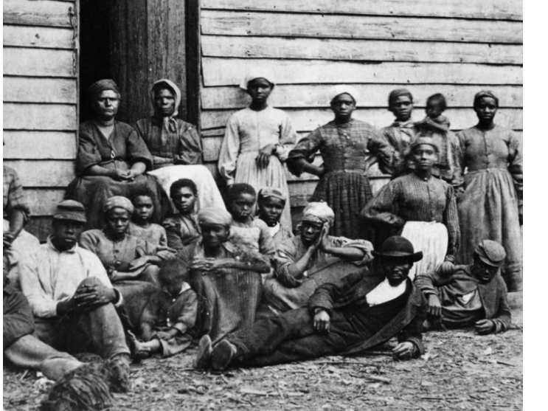
Celebrate Juneteenth
America’s second Independence Day

Slide 3
Overview of the Week
Unit planning including learning targets, formative assessments, strategies for academic language development, instructional strategies that encourage student talk
Beginning of year activities
Practices for orchestrating productive math discussions
Jeff Zwiers on developing academic language
New Problem of Practice for fall 2017

