Slide 1
Franklin-McKinley Math Institute
June 22, 2017

Slide 2
Formative Assessment
Re-engagement Lessons
A special lesson using student work to:
  Confront misconceptions
  Provide feedback on student thinking
  Help students deepen their learning
  Make connections between mathematical ideas
  Make generalizations about types of problems
  Learn a new strategy
  Model qualities or characteristics of good performance on the task

Slide 3
Lesson progression
Start with simple problem so Ss clarify and articulate their thinking
Make sense of another person’s strategy
Compare and contrast strategies
Focus on sense-making

Slide 4
Lesson Protocol
Individual think time
Pair-share
Whole class discussion

Slide 5
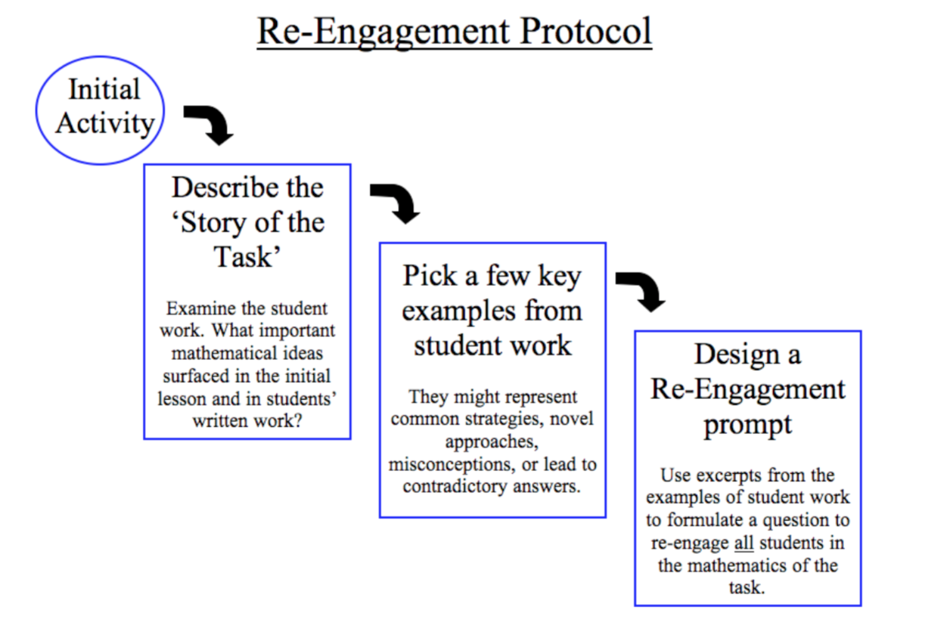

Slide 6
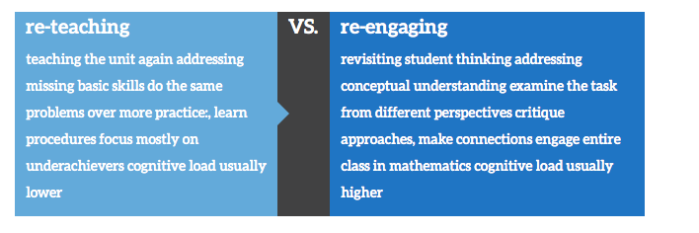

Slide 7
Designing a Lesson
What are the big mathematical ideas of the task?
How was the task designed? How did the design contribute to the cognitive demand?
What are some common errors?
What are some interesting strategies?
How do we bring students along from where they are to “grade-appropriate” strategies?

Slide 8
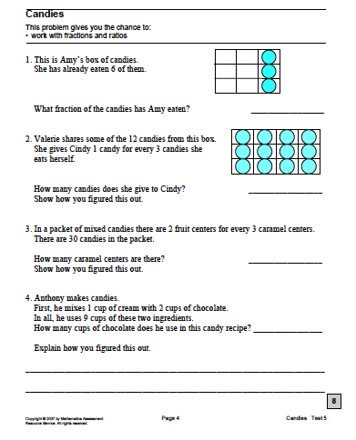

Slide 9
Work the task
What strategies might students use for the task?
What are the big mathematical ideas being assessed?

Slide 10
Student Work
Select 1, 2 or 3 piece(s) of student work and tell:
  Why did you choose this work?
  What is the core mathematics inherent in this work?
  Is this work an example of a misconception, a strategy you want students to make sense of, something you want students to compare and contrast, or moving to generalization? Explain.
  What is the prompt question you are going to pose about this student work?
  What foundational question will you be ready to pose to your students so that they can engage in this prompt?
Be prepared to share with whole group.

Slide 11
Reengage Video
Watch the video and note questions asked.
How does the teacher engage all students in reconsidering the problem?
How do examples chosen push students’ thinking to a deeper level?

