Slide 1
Franklin-McKinley/SJSU Math Institute
Friday, June 17, 2016

Slide 2
Today’s Agenda
8:00-8:30 Refreshments
8:30-9:30 Post Assessment
9:30-10:45 Division of fractions - Cheryl
10:45-12:00 Proportional reasoning - Joanne
12:00-12:30 Lunch
12:30-3:30 Planning and Application: Refining
your Problem of Practice
3:30-3:50 FMMI Next Steps--Ferdie
3:50-4:00 Survey and Problem of Practice

Slide 3
Division
Extending whole number division to fractions.
Overview of learning progressions.
Division of fractions without remainders.
Division of fractions with remainders.
Making sense of the division algorithm.

Slide 4
The Doorbell Rang Revisited
Recall the story The Doorbell Rang, where cookies were being shared among friends. We can extend this scenario to include fractions.
You have 9 cookies and want to give equal portions to 6 friends. How many cookies can each friend have?
If you have 6 cookies and want to give each friend 2/3 of a whole cookie, how many friends can you give a portion to?
What models of division are used here?
Demonstrate the solutions using pattern blocks or pictures.
Notes:
The first problem consists of whole numbers, but the answer is a fraction. (Sharing Model) The second problem is a measurement problem.

Slide 5
Learning Progression:
Grade 5
Apply and extend previous understandings of multiplication and division to multiply and divide fractions.
3. Interpret a fraction as division of the numerator by the denominator (a/b = a ÷ b). Solve word problems involving division of whole numbers leading to answers in the form of fractions or mixed numbers, e.g., by using visual fraction models or equations to represent the problem.

Slide 6
Grade 5 Standards
7. Apply and extend previous understandings of division to divide unit fractions by whole numbers and whole numbers by unit fractions.
a. Interpret division of a unit fraction by a non-zero whole number, and compute such quotients. For example, create a story context for (1/3) ÷ 4, and use a visual fraction model to show the quotient. Use the relationship between multiplication and division to explain that (1/3) ÷ 4 = 1/12 because (1/12) × 4 = 1/3.
b. Interpret division of a whole number by a unit fraction, and compute such quotients. For example, create a story context for 4 ÷ (1/5), and use a visual fraction model to show the quotient. Use the relationship between multiplication and division to explain that 4 ÷ (1/5) = 20 because 20 × (1/5) = 4.
c. Solve real-world problems involving division of unit fractions by non-zero whole numbers and division of whole numbers by unit fractions, e.g., by using visual fraction models and equations to represent the problem. For example, how much chocolate will each person get if 3 people share 1/2 lb of chocolate equally? How many 1/3-cup servings are in 2 cups of raisins?

Slide 7
Grade 6 Standard
Apply and extend previous understandings of multiplication and division to divide fractions by fractions.
1. Interpret and compute quotients of fractions, and solve word problems involving division of fractions by fractions, e.g., by using visual fraction models and equations to represent the problem.

Slide 8
The Richness of Children’s Fraction Strategies
Laura B. Kent, Susan B. Empson, and Lynne Nielsen
You have 4 2/3 cups of hot chocolate powder. Each serving requires 2/3 cup hot chocolate powder. How many servings can you make?

Slide 9
Looking at student work
Solve the problem without using the algorithm. Try to come up with more than one way students might solve this problem.
Take a look at the student work. Describe the method and model used by each student.
What understandings of fractions have the students demonstrated?

Slide 10
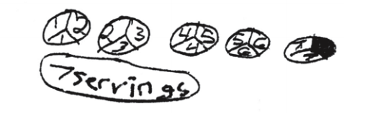
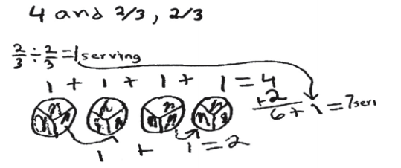
Fifth grade student responses
Maggie’s solution:
Gabriela’s solution:

Slide 11
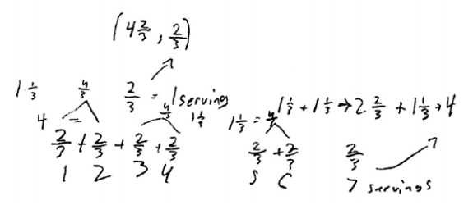
Jake’s strategy:
Olivia’s strategy:

Slide 13
Dealing
with
Remainders

Slide 14
A large container in the refrigerator has 2 ¾ cups of yogurt in it. One serving of yogurt is 1/2 cup. How many servings of yogurt are in the large container?
Each of the students solved this problem by drawing diagrams. Jonathon says that the answer is 5 ¼. Gregory says that the answer is 5 ½.
Which student is correct and why?
What misconceptions are evident?
What questions could you ask the student to move him forward in his understanding of dealing with remainders in fraction problems?

Slide 15
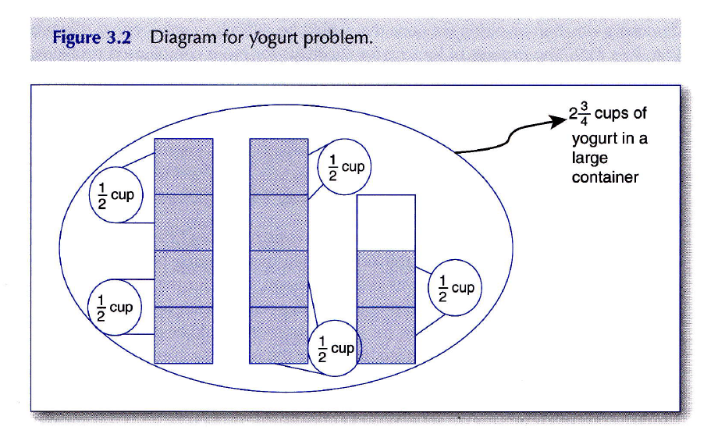
Conceptual Solution
Notes:
Is the answer 5 ½ or 5 ¼? Instead of showing slide, have teachers share their solutions.

Slide 16

Procedural Solution
$2 \frac{3}{4}$ ÷ $\frac{1}{2}$
= $\frac{11}{4}$ ÷ $\frac{1}{2}$
= $\frac{11}{4}$ x $\frac{2}{1}$
= $\frac{22}{4}$
= 5 $\frac{2}{4}$
= 5 $\frac{1}{2}$

Slide 17
All of these word problems can be solved by children without knowing the traditional algorithm.

Slide 18
1. Inga was making a cake that called for 4 cups of flour. However, she could only find a two-thirds measuring cup. How many two-thirds measuring cups of flour will she need to make her cake?
2. Wayne has 5 liters of soda and he puts 2/3 liter of soda in each glass. How many glasses can he fill?
3. Wayne has 2/3 liter of soda and he fills 5 glasses. How much of a liter is in each glass?
4. If one loaf of bread requires 1 cups of flour, then how many loaves of bread can you make with 3 cups of flour?
Use manipulatives and/ or diagrams to solve these problems.

Slide 19
Making sense of the division algorithm
How can you justify the following?
5 ÷ 2 = 5 x 3
3 2
Try to think of more than one way.

Slide 20
Linking to your Curriculum
Choose some division word problems from your instructional materials that can be modeled with pictures, manipulatives, or tape diagrams.
Demonstrate the solution to your chosen word problems.

Slide 21
If time permits, look at some CAASPP items.

Slide 22
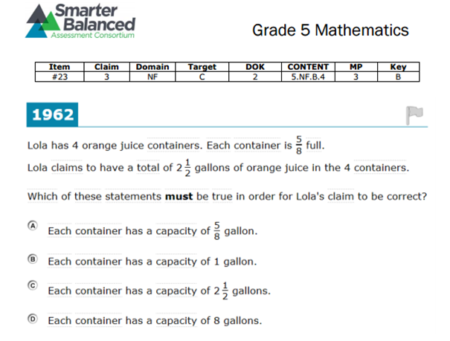

Slide 23
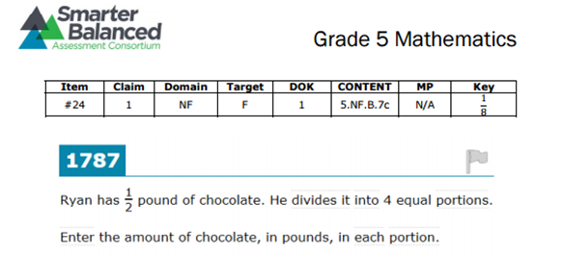

Slide 24
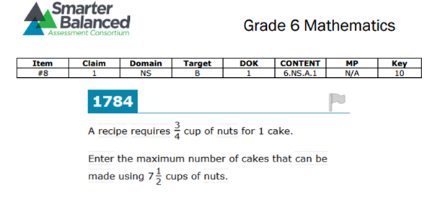

Slide 25
Afternoon sessions

Slide 26
Defining your Problem of Practice
Identify a Problem of Practice for your fall focus;
Investigate CAASPP released tasks;
Select and adapt a task from CAASPP or MARS to give your students in fall to bring in student work for October session;
Anticipate misconceptions students might have;
Create some probing questions and organize possible feedback to student responses.

Slide 27
Survey

