Slide 1
Geometry
January 17, 2017
Grades 3-5
FMMI Institute

Slide 2
Content Domains
Shapes and
Properties
Location
Transformation
Visualization
Levels of Thought
Shape Sorts Story book descriptions | Hidden Positions Storybook descriptions | Motion Man *slides *turns *flips | Face matching Quick Images
Geoboard Riddles Mystery Shape | Objects on Coordinate grid | Moving objects on a coordinate grid Rigid transformations Translations Rotations Reflections Or not Dilations | Viewpoints Pentominoes
Hierarchical categorization Possible- Impossible | Algebraically representing transformations on a coordinate grid | Algebraically representing transformations on a coordinate grid | Search for Platonic Solids
Level O
Visualization
“what it looks like”
Level 1
Analysis
~…classes of shapes,
properties
Level 2
Informal Deduction
~If …then…
~hierarchies of
shapes

Slide 3
Shape Sorts
Informal language to formal
Student generated categories
TPR
Game strategies leading to hierarchical thinking (mystery shapes)
Mathematical notation (index card shapes)

Slide 4
Geoboard Shapes
Level 0 -> 1 -> 2
1) Geoboard Copy
2) Property riddles
3) Possible impossible

Slide 5
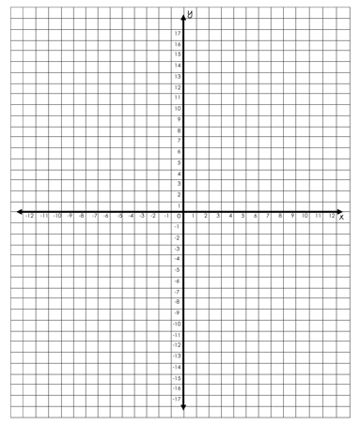
Location and Transformations

Slide 6
Visualization
Face Matching and Art
Quick Images
2-D to 3-D

