Slide 1
From Fractions to Ratios
Joanne Rossi Becker
Franklin McKinley Math Institute

Slide 2
Where are ratios used?
Think-pair-share
  Where are ratios used later in the math/science curriculum (middle school or high school)?
  Where are ratios used in everyday life?
Whole group share
Notes:
5 min think
5 min pair share
5 min to whole group share

Slide 3
Big Ideas in Ratio/Proportion
Invariance: When 2 quantities are related proportionally, the ratio of one quantity to the other is invariant as the numerical values of both quantities change by the same factor
Essential Understandings:
  Ratio is a multiplicative comparison of 2 quantities
  If one quantity in a ratio is multiplied or divided by a particular factor, then the other quantity must be multiplied or divided by the SAME factor to maintain proportional relationships
  A number of mathematical connections link ratios and fractions
  Ratios can be meaningfully reinterpreted as quotients
  A proportion is a relationship of equality between two ratios
  A rate is a set of infinitely many ratios
Notes:
Read over the essential understandings. Discuss in your group what you think each means. 5 min

Slide 4
Grade 6: Ratios as fraction (and rate)
Understand ratio concepts and use ratio reasoning to solve problems.
6.RP.1 Understand the concept of a ratio and use ratio language to describe a ratio relationship between two quantities.
  For example, “The ratio of wings to beaks in the bird house at the zoo was 2:1, because for every 2 wings there was 1 beak.” “For every vote candidate A received, candidate C received nearly three votes.”
6.RP.2 Understand the concept of a unit rate a/b associated with a ratio a:b, and use rate language in the context of a ratio relationship.
  For example, “This recipe has a ratio of 3 cups of flour to 4 cups of sugar, so there is ¾ cup of flour for each cup of sugar.” “We paid $75 for 15 hamburgers, which is a rate of $5 per hamburger.”
  We don’t distinguish between ratios and rates (old view).
Notes:
5 min for next 2 slides

Slide 5
Ratios sometimes behave like fractions
“In a school, every room has 3 boys and 5 girls.”
Fractions as measures: a/b means -
Identify the unit first: 1/b
Perform the iteration: Scale 1/b a times.
To form a ratio:
Identify a unit first. Example: boy to girl, girl to boy, boy to group of boys and girls, girl to group of boys and girls.
Then form the fraction: 3/5, 5/3, 3/8, 5/8

Slide 6
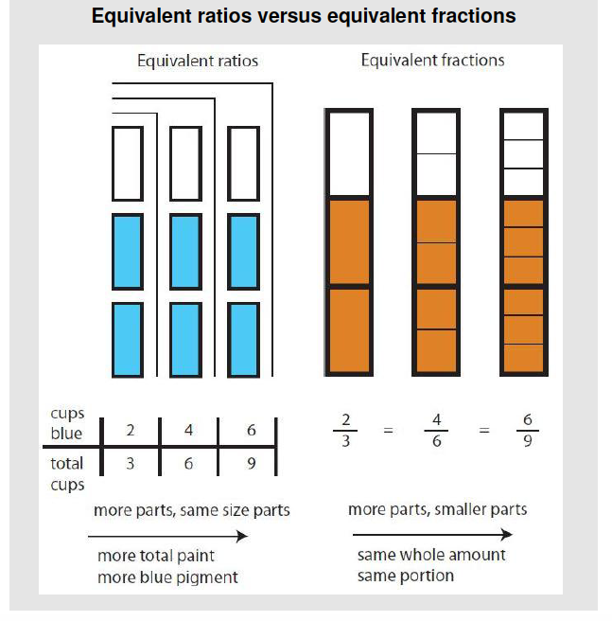
Notes:
Example of differences between ratios and fractions

Slide 7
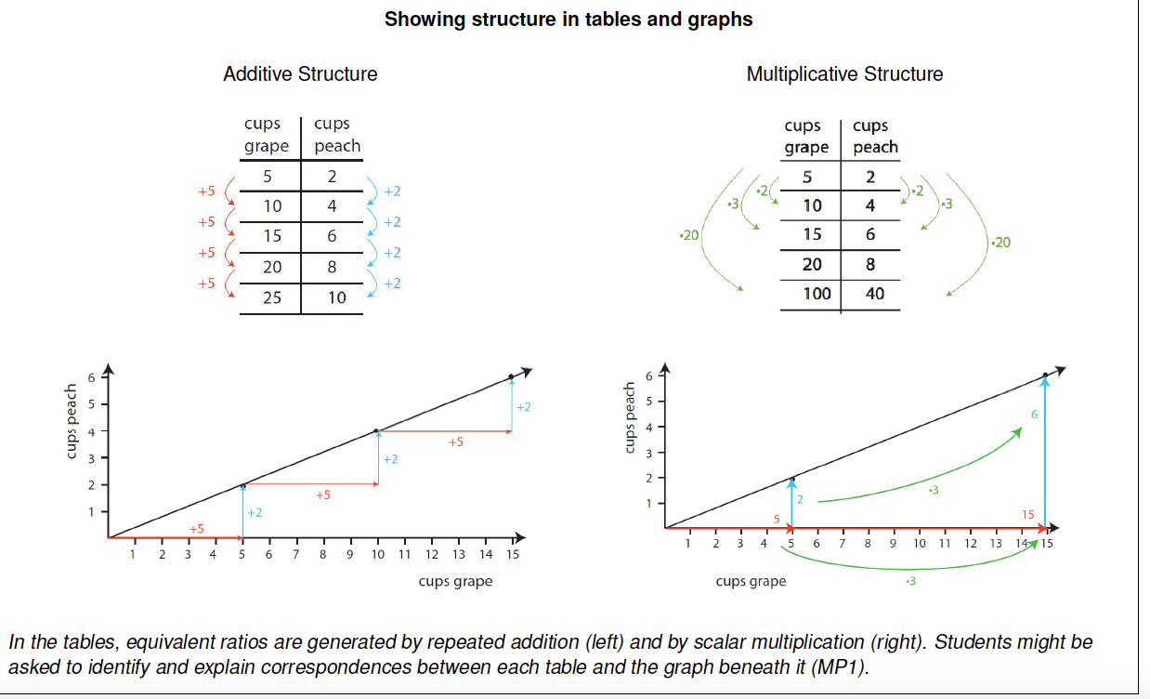
Notes:
Models or representations for ratios 5 min

Slide 8
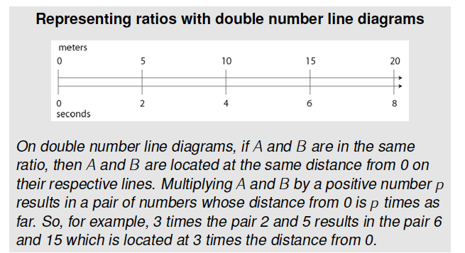

Slide 9
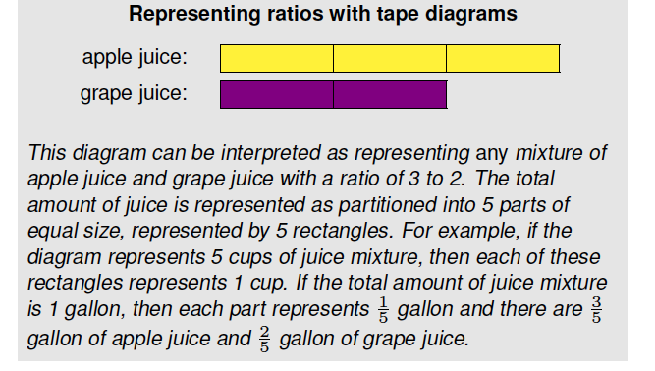

Slide 10
Ratio of Boys to Girls
The ratio of the number of boys to the number of girls at school is 4:5.
  What fraction of the students are boys?
  If there are 120 boys, how many students are there altogether?
  Solve part b with
    A tape diagram (bar model)
    A table
    Another method of your choice
Notes:
Solve individually 3
Check in with your elbow partner 3
Whole group sharing 10

Slide 11
Levels of Proportional Thinking
Level 0: Non-proportional reasoning
  Guesses or uses visual cues
  Is unable to recognize multiplicative relationships
  Randomly uses numbers, operations or strategies
Level 1: Informal reasoning about proportional situations
  Uses pictures, models or manipulatives
  Makes qualitative comparisons
Level 2: Quantitative reasoning
  Unitizes or uses composite units
  Finds and uses unit rate
  Identifies or uses scalar factor or table
  Uses equivalent fractions
  Builds up both measures
Level 3: Formal proportional reasoning
  Sets up proportion using variables and solves using cross-product rule or equivalent fractions
  Fully understands that the ratio between two values stays constant even though the values themselves may change
Notes:
5 min

Slide 12
Solve the problems provided
School Group
Ms Ortiz put her students into groups of 6. Each group had 4 boys. If she had 42 students, how many girls and how many boys are in her class?
Pencil Cases
Antonio, Rochelle and Anh bought 3 pencil cases and paid $2 for all three. They decided to go back and buy 24 cases so everyone in their class could have one. How much did they pay for 24 cases?
Lap Running
Cal and Jan run at the same pace. Cal started running laps before Jan arrived. Cal had run 8 laps when Jan had run 2. How many laps had Cal run by the time Jan had run 12?
Field mowing
If 3 students take 5 hours to mow a field, how long would 6 students take to mow the same field?
Notes:
5 min to work
10 min for sharing

Slide 13
Analyze student work
Analyze each student’s thinking.
If there is an error or misconception, discuss its nature.
What questions or other problems would you pose?
What materials might you introduce to help the student?
If the answer is correct, describe the strategy used.
Determine the level of the students’ thinking as best you can given the limited information from their work.
Notes:
Assign student work to each group
Give 20 min for task
15 min discussion of each student example

Slide 14
Formative Assessment Lessons
See map.mathshell.org
http://map.mathshell.org/lessons.php?unit=6230&collection=8
Do pre-assessment, considering the kind of difficulties students might have with the task.
Notes:
20 min with discussion

Slide 15
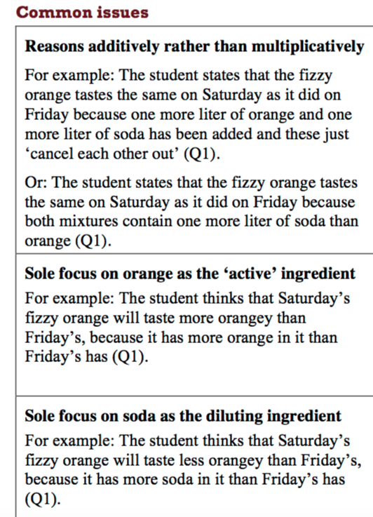
What questions or prompts would you use for each difficulty?

Slide 16
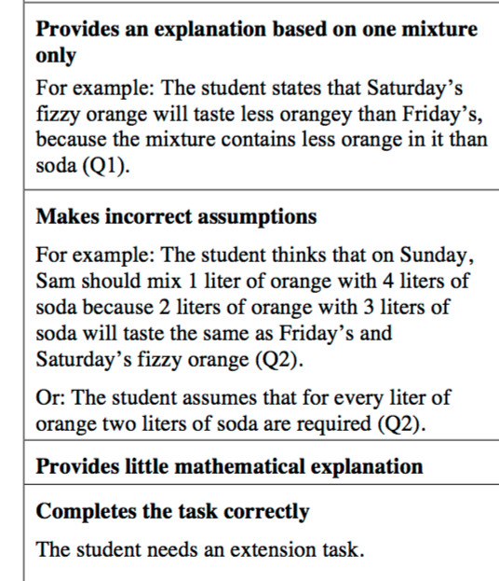
What questions or prompts would you use for each difficulty?

Slide 17
Emmanuel
What do you think about Emmanuel’s thinking? Is he right or wrong?
What might you as a teacher do to help Emmanuel?

Slide 18
Emmanuel’s Reasoning

Slide 19
Sifi
What might you as a teacher do to help Sifi?

Slide 20
Sifi’s Reasoning

Slide 21
Alex
What might you as a teacher do to help Alex?

Slide 22
Alex’s Reasoning

Slide 23
Follow-up Activity
Have students arrange the cards from least orangey to most orangey, using a pictorial representation to match a verbal one. They create cards if there is no match.

Slide 24
More on ratio?
This is just a beginning of this critical middle school topic.

