Slide 1
Franklin-McKinley/SJSU Math Institute
June 13, 2016

Slide 2
Today’s Agenda
8:00-8:30 Refreshments
8:30-9:30 Pre-assessment
9:30—10 Overview of 5-day Outcomes & Project-Ferdie
10-10:30 Develop group work norms-Patty
10:30-12:00 Representations of Multiplication/Division -Cheryl
Learning Progressions for Multiplication/Division- Patty
12:00-12:30 Lunch
12:30-1:20 Group Work Activity: Cover Up - Patty
1:30-3:00 Judit Moschkovich
3:00-3:50 Debrief Moschkovitz and Zwiers, Building Academic Language
3:50-4:00 Survey

Slide 3
Building
Cooperative Norms
Patricia Swanson
San José State University

Slide 4
High Leverage Practices in Mathematics
1. Explaining core content
2. Choosing and using representations, examples, and models of content
3. Designing a sequence of lessons on a core topic
4. Enacting a sequence of lessons on a core topic
5. Using homework equitably
6. Setting up and managing small-group work
7. Using public recording (posters, whiteboard)
8. Establishing norms and routines for classroom discourse and work that are
central to the content
9. Working with individual students to elicit, probe, and develop their thinking
about content
10. Recognizing and identifying common patterns of student thinking in a
content domain
11. Identifying and implementing an instructional strategy or intervention in
response to common patterns of student thinking
12. Leading a productive whole class math discussion
13. Teaching and using a academic language
14. Choosing, appraising, and modifying tasks, texts, and materials for a specific
learning goal
14. Composing, selecting, adapting quizzes, tests, an other methods of assessing
student learning of a chunk of instruction
16. Selecting and using specific methods to assess students’ learning on an
ongoing basis within and between lessons

Slide 5
Groupwork in Heterogeneous Classrooms
Instructional
Strategies
Curriculum
Group-worthy tasks
Complex Instruction
Management
of groups
Access
Treatment of status problems
E. G. Cohen & R. A. Lotan
Designing Groupwork: Strategies for the Heterogeneous Classroom

Slide 6
Cooperative Norms
Look out for what others need.
No one is done until everyone is done.
Explain by telling how.
Ask questions.
Let people do things for themselves.
Everyone helps.
Make a plan.
Agree on a strategy.
Discuss and decide. Rainbow Logic
Explain your reasoning.
Broken Circles or
Squares
Master Designer
Island Maps or
Lots of Dots

Slide 7
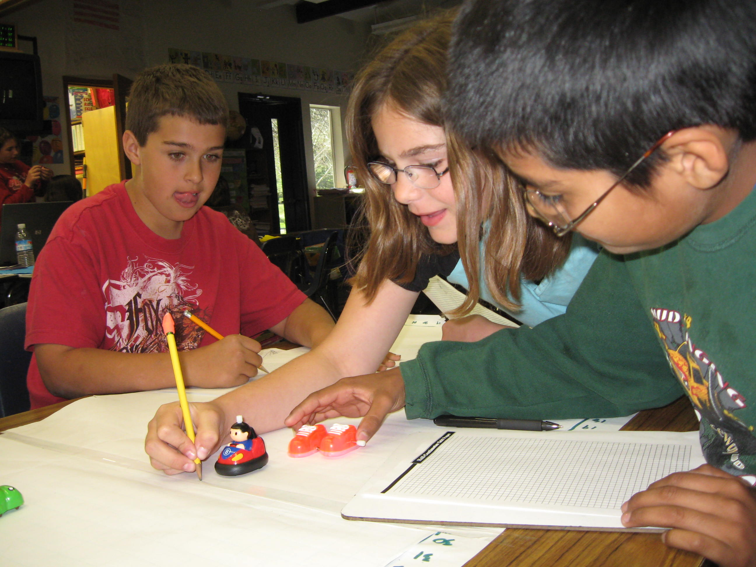
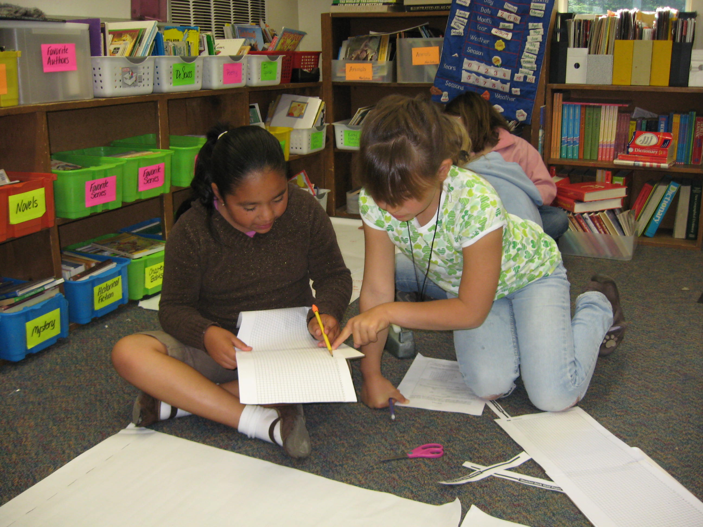
Shape your learning environment
Build classroom community
Explicitly teach norms for
working together and
communication skills.
Broken Squares
Look out for what others need
No one is done until everyone is done
Master Designer
Explain by telling how
Ask specific questions

Slide 8
Your Task…..
Implement the Cooperative Skillbuilders to prepare your class for collaborative groupwork at the beginning of the school year.

Slide 9
Representations of Multiplication and Division

Slide 10
Representations of Multiplication and Division
Model the following word problems with manipulatives and/or drawings.
Place each problem in a group according to the operation and the specific moves that can be used to solve each problem.

Slide 11
There are 4 rows of chairs in the band room. Each row has 6 chairs. How many chairs are in the band room?
Sue has 4 blouses and 3 skirts. How many different outfits can she make?
Juan has 24 strawberries that he shared evenly with his 4 friends, keeping none for himself. How many strawberries did each of Juan’s friends receive?
There are 12 apples in a carton. Each bag can hold 4 apples. How many bags are needed to hold all of the apples?
Jon bought 4 packages of pencils. Each package has 3 pencils. How many pencils did he buy altogether?
Austin likes to watch squirrels find and store acorns for the winter. Gray Squirrels can carry three acorns at a time and there is a pile of 24 acorns. How many trips would a Gray Squirrel need to make to store all of the acorns in the pile?
A teacher gives 6 students some cards to play a game. She has 52 cards total. The teacher gives each student 1 card until all 52 cards are gone. Home many students get exactly 9 cards?
Nicole is helping set up tables in the cafeteria. Each table in the cafeteria seats 8 students. Fourth grade students must fill a whole table before sitting at another table. There are 32 fourth grade students. How many tables does Nicole need to set up?
There are two loaves of bread in each row. How many loaves of bread are there in 5 rows?
Jordan uses 3 lemons to make a pitcher of lemonade. He makes 4 pitchers. How many lemons does he use altogether?
The cost of buying a movie is 4 times the cost of renting a movie. It costs $20 to buy a movie. What is the cost, in dollars, of renting a movie?
A cat has 2 times as many toys as a puppy. The cat has 12 toys. How many toys does the puppy have?
A cat has 6 toys and a puppy has 12 toys. How many times as many toys does the puppy have?
Jill picked 6 apples. Mark picked 4 times as many apples as Jill. How many apples did Mark pick?

Slide 12
Representations of Multiplication
Equal Groups (Repeated Addition)
Array
Area
Cartesian Product

Slide 13
Representations of Division
Number of Groups Unknown (Also called Measurement or Repeated Subtraction)
Size of Group Unknown (Also called Partition or Sharing)

Slide 14
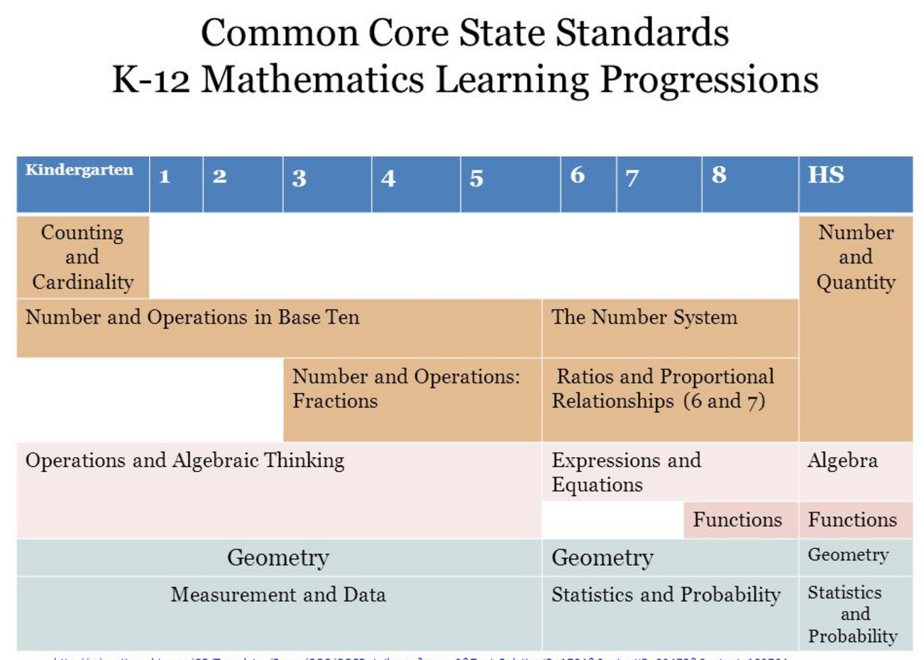
Notes:
Research based learning progressions, based on what we know about how children learn math
What do we know about the sequence of teaching, how children’s ideas evolve and how do we set the stage so that they connect key understandings and representations of how operations work, and then generalize these understandings from discrete to continuous numbers.Similarly, what do we know about common student misconceptions……the learning progressions detail a sequence of key understandings we are trying to develop as children move through the grade levels.

Slide 15
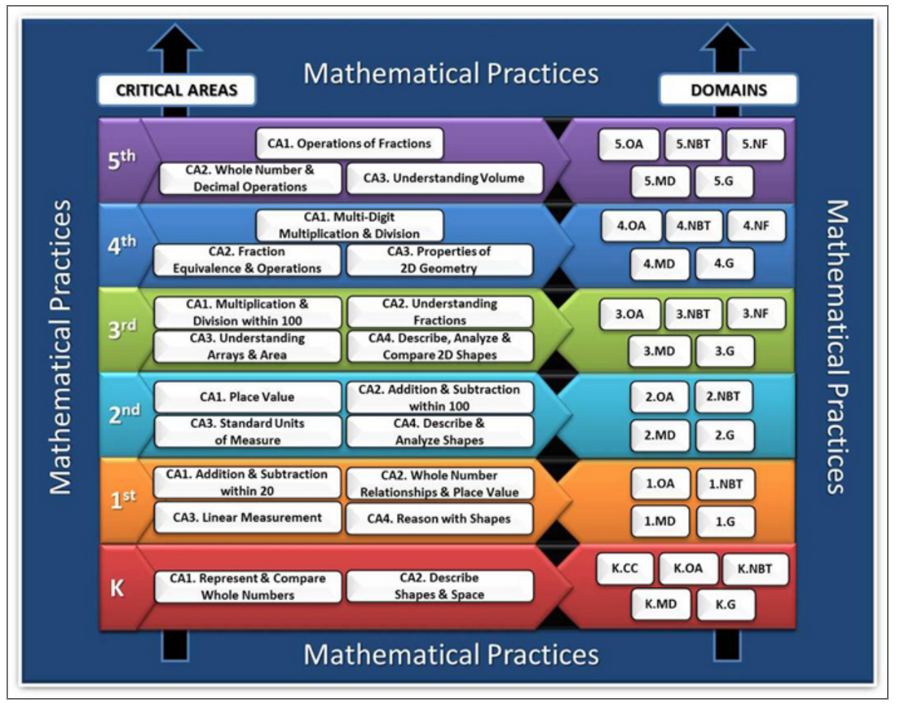
Multiplication Learning Progressions
Trace the multiplication strand from 3rd through 5th grade.

Slide 16
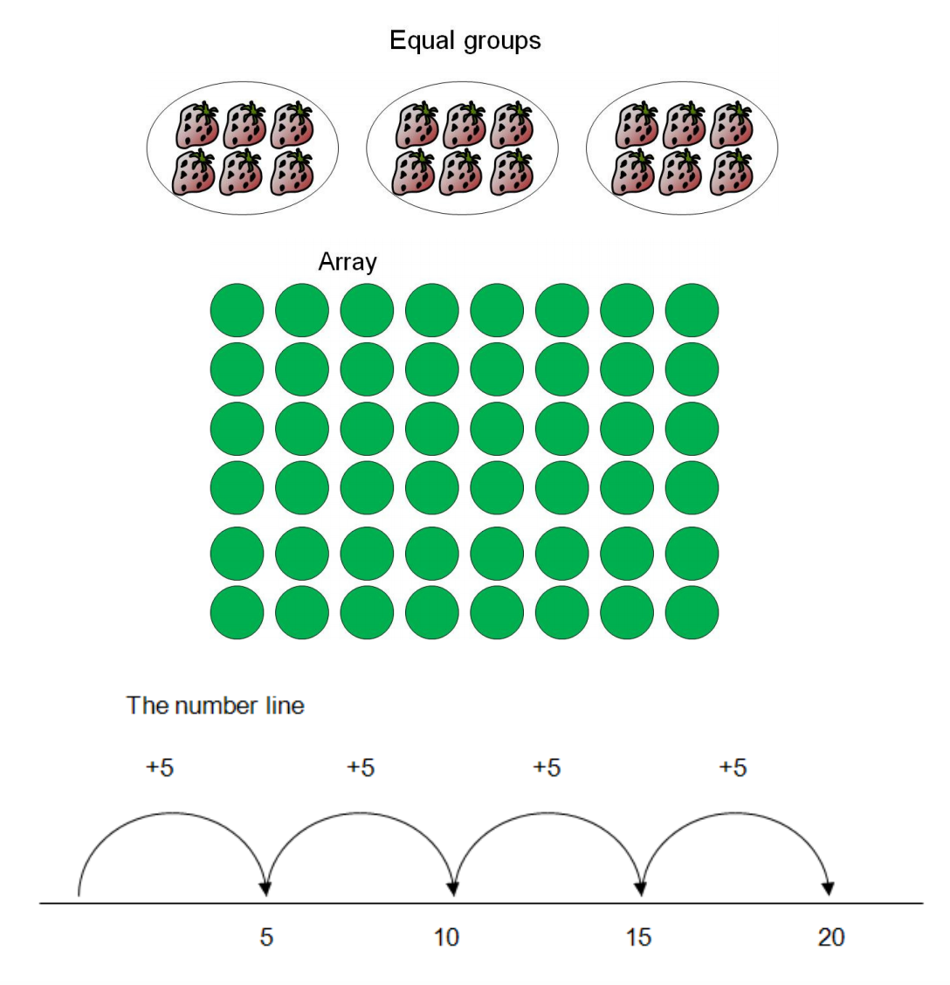
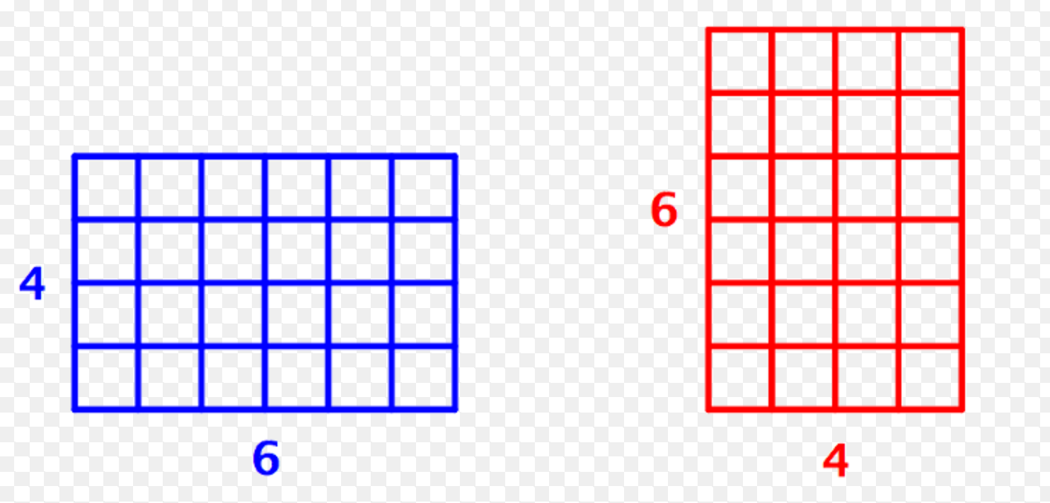
Third Grade
Area Model
Excellent children’s literature
Amanda Bean’s Amazing
Dream (Neuschwander)
Each Orange Had 8 Slices
(Giganti)

Slide 17
4th Grade
A new addition…
Multiplicative Compare Problems
“times as much as…”
“A blue hat costs 5 dollars. A red hat costs
three times as much as the blue hat. How
much does the red hat cost?”
or
“A red hat costs 15 dollars and that is three
times as much as the cost of the blue hat.
How much does the blue hat cost?”

Slide 18
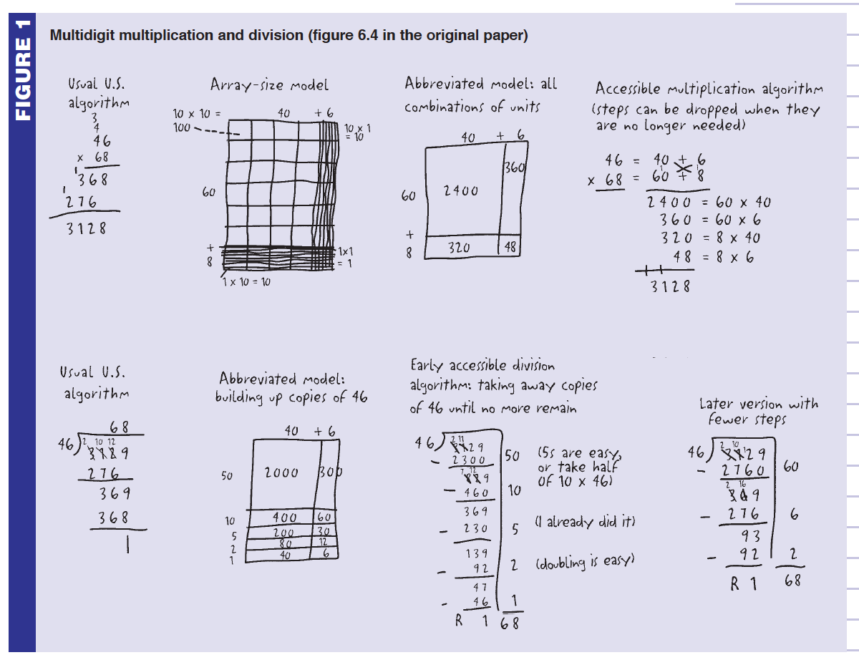
4th and 5th grade
multi-digit multiplication and division
Notes:
Note importance of place value 46=40 + 6 and the distributive property
4th working with whole numbers, 5th multiplying and dividing whole numbers, decimals and fractions

Slide 19
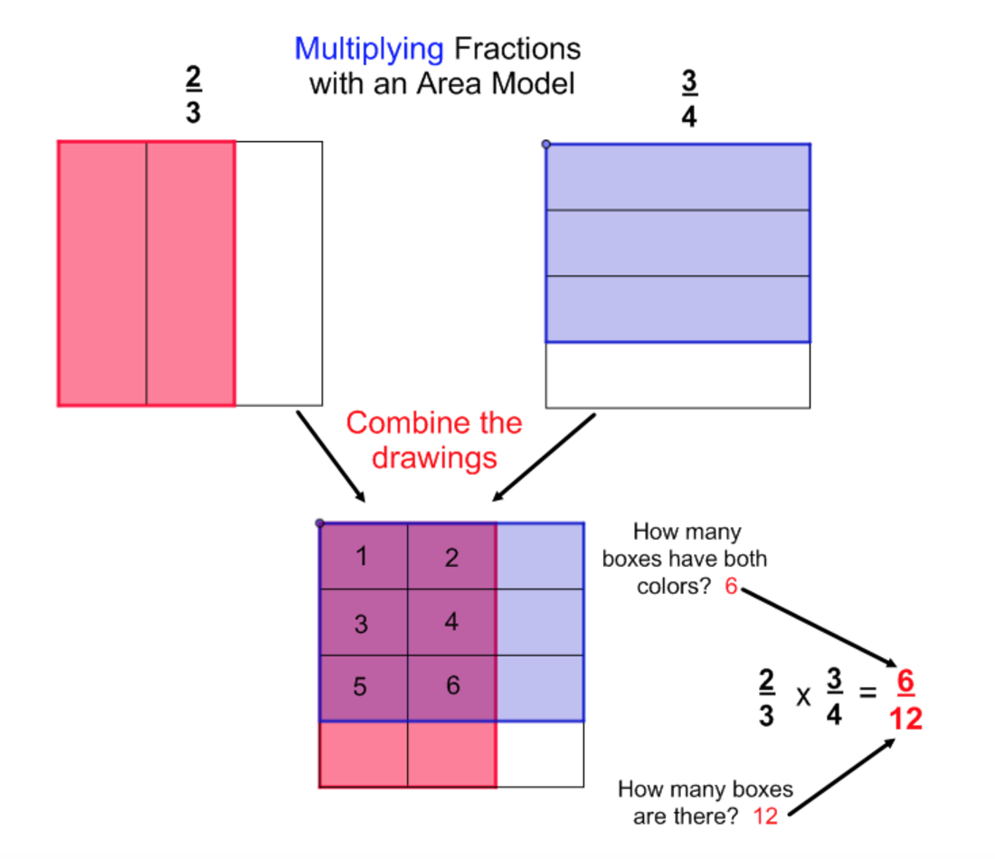
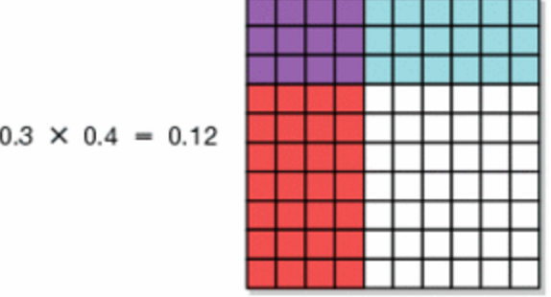
5th Grade
Generalizing the operations to
fractions, decimals, mixed numbers…

Slide 20
6th Grade
New Learning Progressions
Challenge: Can you find a 6th grade progression that does not rely extensively on multiplicative thinking?
Notes:
Research based learning progressions, based on what we know about how children learn math
What do we know about the sequence of teaching, how children’s ideas evolve and how do we set the stage so that they connect key understandings and representations of how operations work, and then generalize these understandings from discrete (whole numbers) to continuous (rational numbers).Similarly, what do we know about common student misconceptions……the learning progression detail a sequence of key understandings we are trying to develop as children move through the grade levels.

