Slide 1
Franklin McKinley Math Initiative Project Overview
Ferdie Rivera
Department of Math & Statistics, SJSU
June 2016

Slide 2
FMMI Project Goals
Improve and strengthen Grades 3-6 teachers’ expertise in creating appropriate learning and learning environments that support the effective implementation of the CACSM for all students.
Develop expertise in solving problems of practice through data.
Examples: My students don’t talk in my math class.
My students have difficulty processing word problems.
My students are confused with adding and subtracting
fractions.

Slide 3
FMMI Visual Framework for Effective Implementation of the CACSM: Thinking in Bundles
CACSM content-practice standards
Formative assessment
Formative assessment
High leverage
bundling
CAASPP-aligned assessments
Formative assessment
CACSM-aligned instructional practices & strategies

Slide 4
FMMI Visual Framework for Effective Implementation of the CACSM
Align EngageNY (3-5) modules and CPM (6) chapters with major clusters
Develop content-practice math lessons that support deep understanding of math
Understand learning progressions of concepts and tasks
Focus on high-leverage concepts of multiplication involving whole numbers and fractions
CACSM content-practice standards
Formative assessment
Formative assessment
High leverage
bundling
CAASPP-aligned assessments
Formative assessment
CACSM-aligned instructional practices & strategies

Slide 5
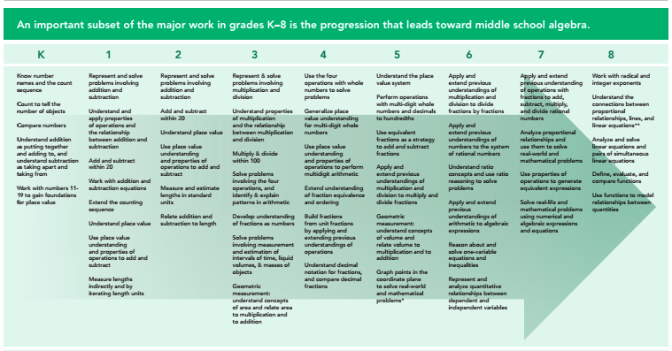
Focus Math Teaching on Major Clusters (achievethecore.org)

Slide 6
Content-practice math lessons
1. Make sense of problems and persevere in solving them.
2. Reason abstractly and quantitatively.
3. Construct viable arguments and critique the reasoning of others.
4. Model with mathematics.
5. Use appropriate tools strategically.
6. Attend to precision.
7. Look for and make use of structure.
8. Look for and express regularity in repeated reasoning.
Major clusters
Deep understanding of math
ability to justify why a particular mathematical statement is true or where a mathematical rule comes from.
Concepts & Problem solving Communicating
Procedures modeling/ reasoning
data analysis

Slide 7
Understand learning progressions of concepts
Example: Why do students need to understand fractions as numbers (3.NF)?
Good Potential Problems
Set model Yes Yes
Area model Yes Yes
Number line Yes No

Slide 8

Understand learning progressions of tasks
Concept of ratio and Ratio Language
Ratio and unit rate reasoning by using tables of equivalent ratios, tape diagrams, double number line diagrams, equations
Ratio and unit rate problem solving: unit pricing; constant speed; percent of a quantity; measurement conversion
Unit Rate
Illustrative Math: In a bag of marbles, 3/5 of the marbles are blue and the rest are red. If the number of red marbles is doubled and the number of blue marbles stays the same, what fraction of the marbles will be red?
CAASPP: Carl types 180 words in 2 minutes. How many words can Carl type in 5 minutes at this rate?
CAASPP: A recipe requires ¾ cup of nuts for 1 cake. What is the maximum number of cakes that can be made using 7 ½ cups of nuts.
CAPP: The table below contains x and y values in equivalent ratios. Fill in the missing value in the table.
x 2 5 7 9
y 6 ? 21 27
CAASPP: 30% of ? Is 60.
CAASPP: Darcy likes to eat peanut butter and raisins on apple slices. On each apple slice she puts 1/16 cup of peanut butter and 8 raisins. Darcy has 2/5 cup of peanut butter and 80 raisins. She eats a whole number of apple slices until the peanut butter is all gone. What fraction of the 80 raisins did she eat?
CAASPP: Complete this expression for converting 10 yards to inches:
(10 yds / 1)(?)(12 in / 1 ft)

Slide 9
FMMI Visual Framework for Effective Implementation of the CACSM
CACSM content-practice standards
Formative assessment
Formative assessment
High leverage
bundling
Concepts & procedures
Problem solving & modeling/data analysis
Communicating
reasoning
CAASPP-aligned assessments
Formative assessment
CACSM-aligned instructional practices
& strategies

Slide 10
Proactively embedding CAASPP tasks in daily content-practice math lessons
Using CAASPP tasks
in formative assessment contexts (ongoing)
as interim assessment tools (mini summatives)
as summative assessment indicators of successful
opportunities for learning
How to engage in forward and reverse inferencing
How to determine which problem tasks in EngageNY and CPM help students deal with CAASPP tasks

Slide 11
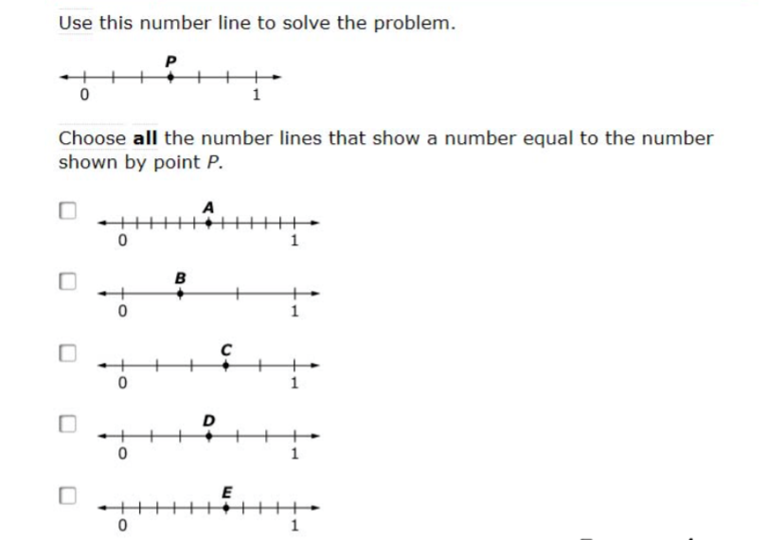
Grade 3 CAASSP Tasks

Slide 12
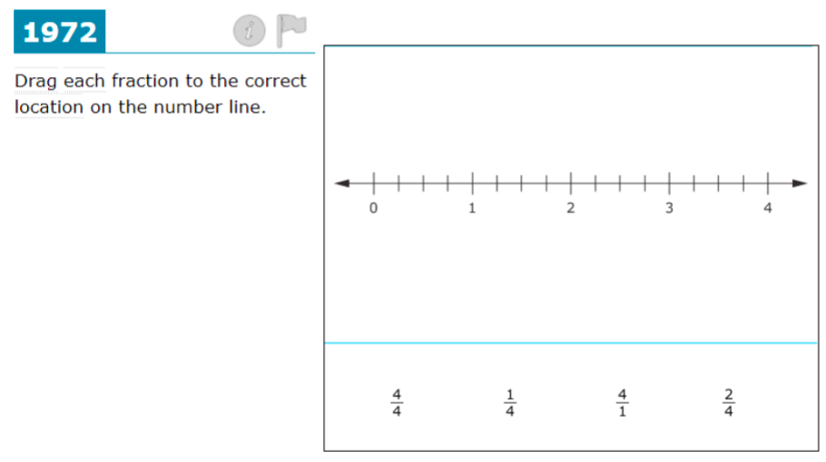
Grade 3 CAASSP Tasks

Slide 13
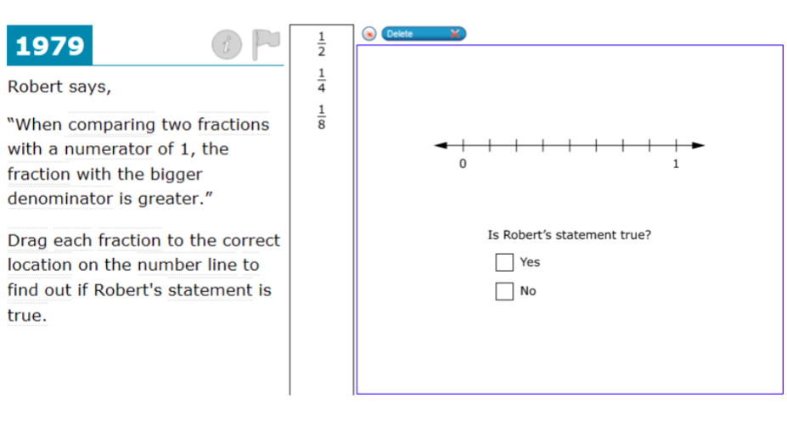
Grade 3 CAASSP Tasks

Slide 14
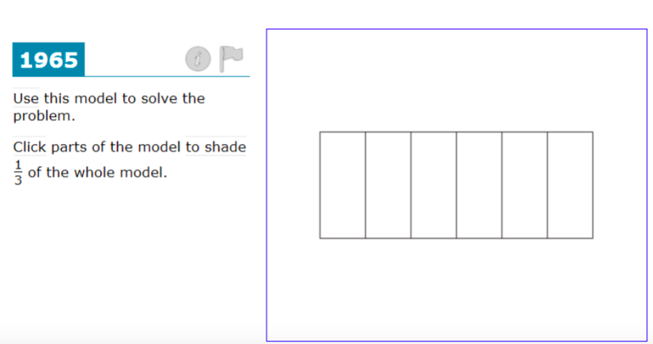
Grade 3 CAASSP Tasks

Slide 15
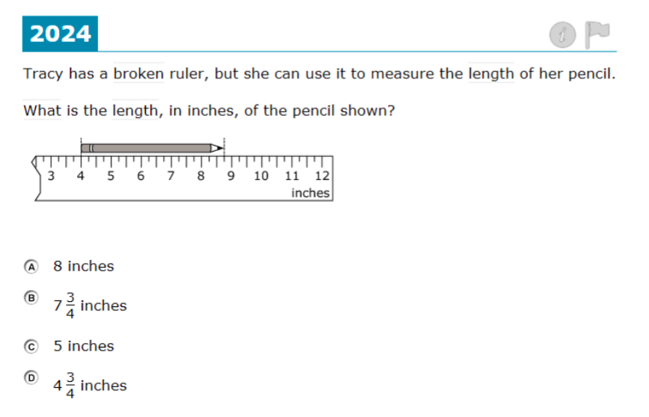
Grade 3 CAASSP Tasks

Slide 16
FMMI Visual Framework for Effective Implementation of the CACSM
CACSM content-practice standards
Formative assessment
Formative assessment
High leverage
bundling
CAASPP-aligned assessments (A)
Formative assessment
CACSM-aligned instructional
practices & strategies
Science of Learning

Slide 17
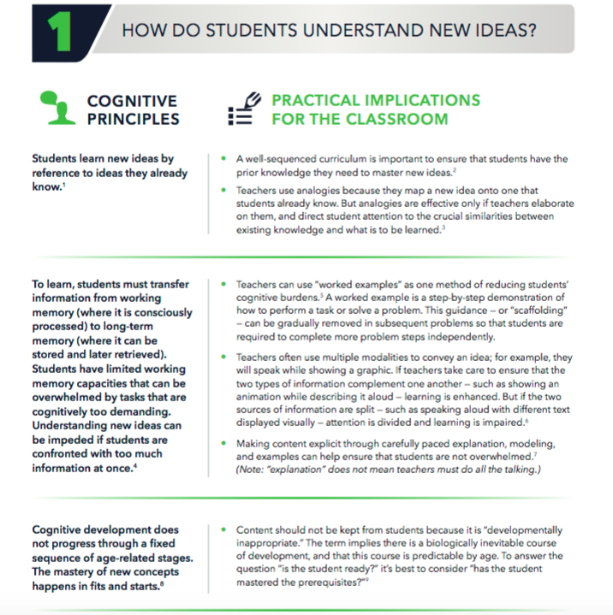
Science of Learning
(http://www.deansforimpact.org/pdfs/The_Science_of_Learning.pdf)

Slide 18
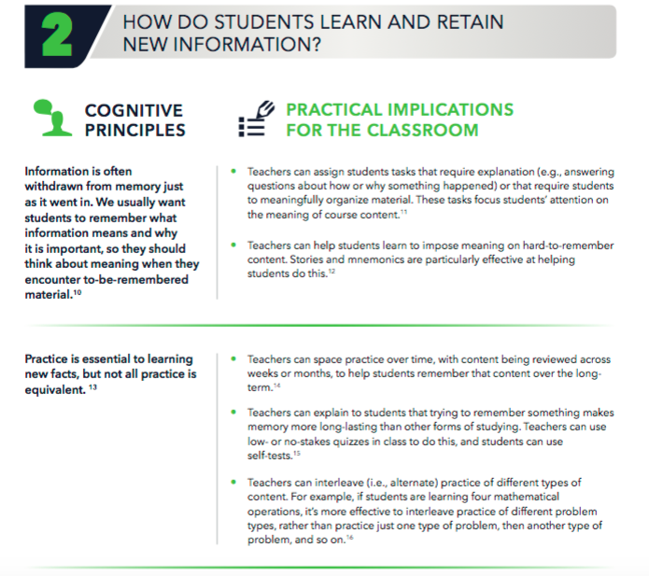
Science of Learning

Slide 19
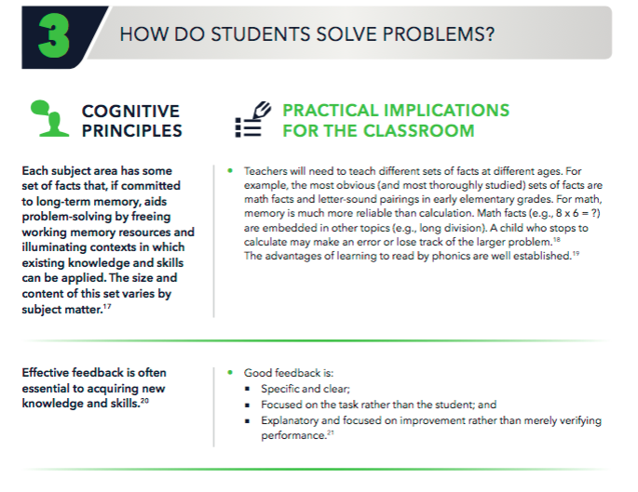
Science of Learning

Slide 20
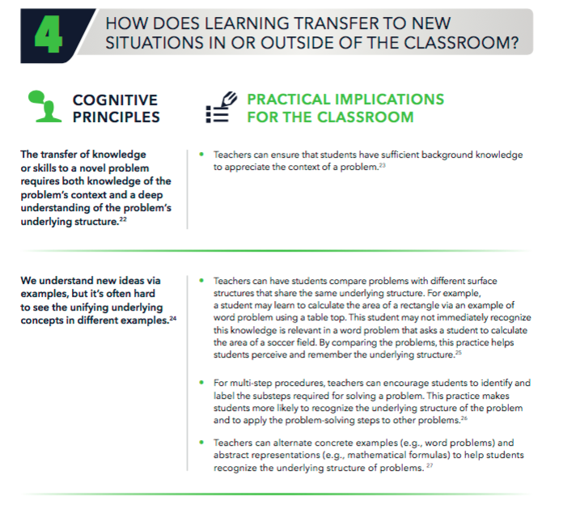
Science of Learning

Slide 21
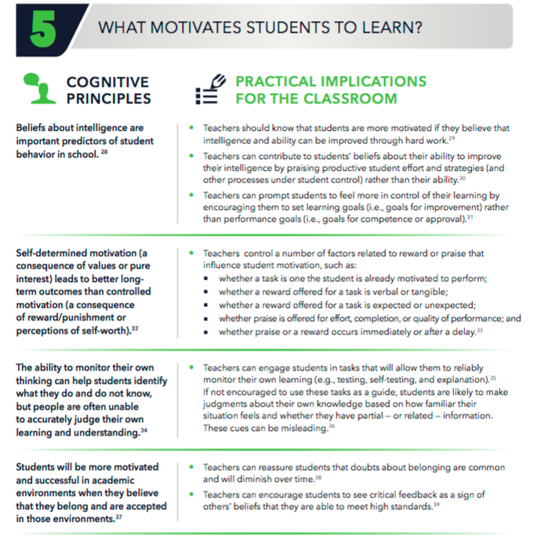
Science of Learning

Slide 22
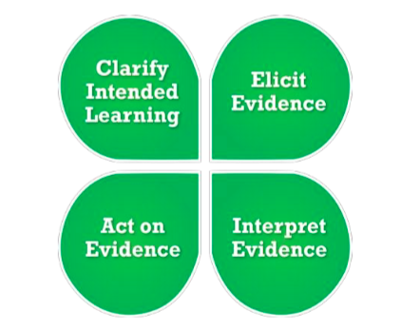
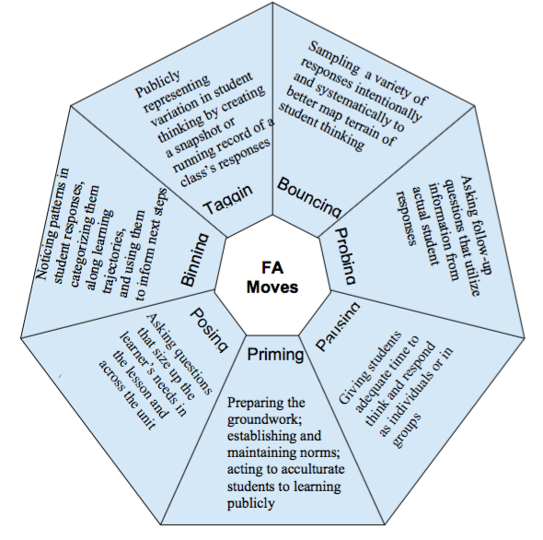
How do you use FA process to assist students transition from DOK 1 to DOK 4?
CDE Formative Assessment Process
Formative Assessment Moves
CACSM content-practice standards
Formative assessment
Formative assessment
High leverage
bundling
CAASPP-aligned assessments
Formative assessment
CACSM-aligned instructional practices & strategies
Cognitive Rigor Matrix

Slide 23
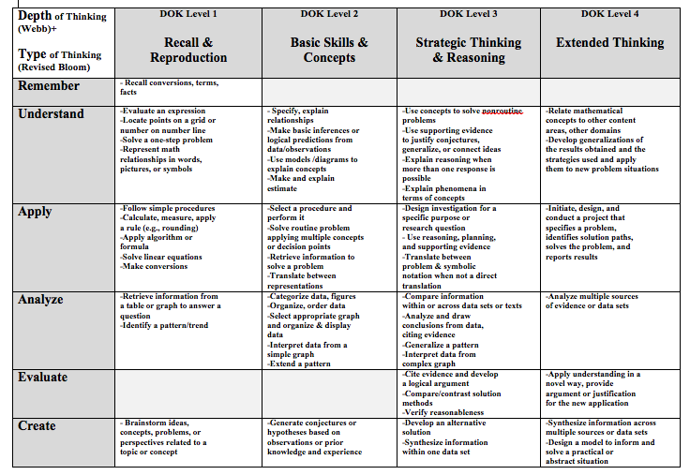
Cognitive Rigor Matrix

Slide 24
Fall 2016 Project
Identify a problem of practice that you and/your team would like to resolve over one semester.
  Identify a target content.
  Identify issues that students have with the content.
  Identify the relevant math units that will be the basis for all your lessons. Check the CAASPP for “desired” level/s of DOK. Choose how you want to assess student learning (formative, interim, and summative) and gather pre- and post- student data.
  Identify one of the Science of Learning classroom strategies that you can use to teach you lessons consistently. Aim to model an FA move that might work well with the strategies.

