Slide 1
Franklin-McKinley/SJSU
Math Institute
September 6, 2016

Slide 2
Today’s Agenda
Welcome!
Introduction to new year
Intro to academic language strand – Margaret
Developing group worthy tasks – Patty
Content sessions
  Helping students master basic X facts gr 3, 4
  Multiplication to ratio gr 5, 6
Short survey

Slide 3
Foundations for Ratio/proportion in gr 3-5
Concept of unit, fractions as measurements, shifting units
Multiple models and representations – area, linear, discrete
Comparison of quantities within and between fractions
Multiplicative thinking
Equivalence and non equivalence
Contextualization
Flexible thinking

Slide 4
Big Ideas in Ratio/Proportion
INVARIANCE
When 2 quantities are related proportionally, the ratio of one quantity to the other is invariant as the numerical values of both quantities change by the same FACTOR

Slide 5
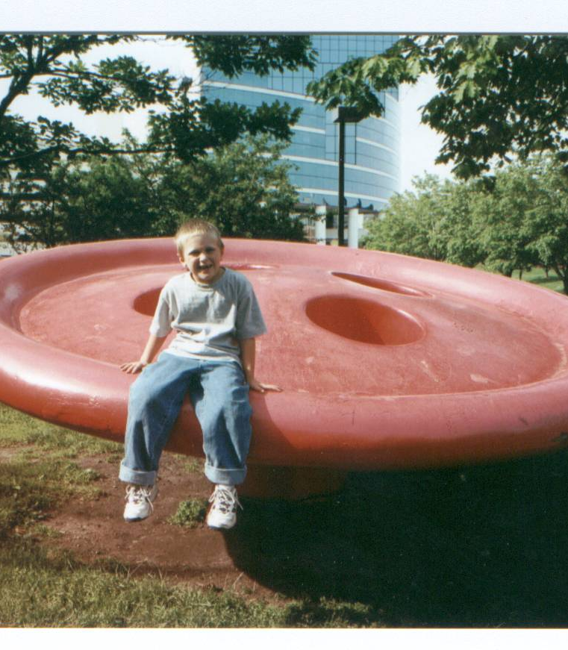
Gavin and the Giant Button
One day while Gavin and his grandma were playing in a park they came across a huge red button. Gavin wondered aloud, “ How big is the giant who lost that button?” Note: the diameter of the button is 12 feet.

Slide 6
Model of Gavin
Build Gavin using tangrams.
Build a model of Gavin’s head enlarging it by a factor of 2 in length only.
What is the geometric relationship between the original model and the enlargement?
Create a model of a giant by enlarging the model of Gavin by a factor of 2 in each dimension.
What happens to the perimeter of the model?
Create a model of a giant by enlarging the tangram model of Gavin by a factor of 3 in each dimension. What happens to the perimeter? Generalize.
What happens to the area of the 2X magnification? 3X? Generalize.

Slide 7
Volume Investigation
Use unit cubes to investigate surface area and volume of a prism magnified 2X, 3X or other factors.
Begin with 1x2x3 units
Conjecture a rule for how surface area and volume change when dimensions are changed by a factor.

Slide 8
Processing
How is this a group-worthy task?
Where might parts of this problem fit into your 5th grade curriculum? 6th grade?

