Slide 1
Franklin-McKinley/SJSU Math Institute
Thursday, June 16, 2016

Slide 2
Today’s Agenda
8:00-8:30 Refreshments
8:30-9:00 Developing socio-mathematical norms: Formative feedback during group work-- Patty
9:00-10:00 Fraction comparison and scaffolding the language of explanation- Patty
10:00 – 12:00 Addition/subtraction of fractions – Joanne
12:00-12:30 Lunch
12:30-2:30 Multiplication of fractions- Cheryl
2:30-3:50 Planning and Application
3:50 – 4:00 Survey

Slide 3

Extending Multiplication from Whole Numbers to Fractions
Write a word problem that can be solved by finding 5 x 4.
Draw two different diagrams that show that 5 x 4 = 20. Explain how your diagrams represent 5 x 4 = 20.
Which of the diagrams you used to represent 5 x 4 = 20 can be used to represent 5 x 2/3? Create a new word problem and adapt your diagrams if possible.
Notes:
Think back to the models we have already discussed for multiplication of whole numbers.

Slide 4

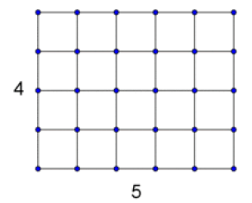

Extending Multiplication from Whole Numbers to Fractions (cont’d.)
Equal Groups (Repeated Addition)
Area Model
Bar Diagram
Notes:
Think back to the models we have already discussed for multiplication of whole numbers.

Slide 5

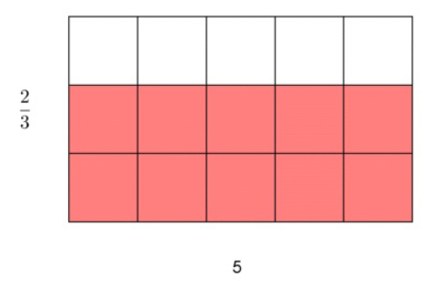

Diagrams adapted for fractions: 5 x 2/3
Equal Groups (Repeated Addition)
Area Model
Bar Diagram
Notes:
Can you adapt the set model for fractions?

Slide 6
Grade Three Standard
Understand a fraction 1/b as the quantity formed by 1 part when a whole is partitioned into b equal parts;
Understand a fraction a /b as the quantity formed by a parts of size 1/b
Notes:
CCSS talks about fractions with different language and emphases than we are used to – but the meanings of fractions and their symbols have not changed.
ASK: Talk in groups – What examples of unit fractions might we use or hear in everyday life? ½ hour; 1/2 of an hour; half time in some sports; measurement – ½ inch etc. Pie sliced into 4 parts - etc.
Defining fractions in terms of unit fractions avoids a major conceptual problem, namely, establishing that a fraction is a number.
A second advantage of defining fractions in terms of unit fractions is that this approach separates the study of the numerator and the denominator of a fraction. Numerators are standard counting numbers and are used to count unit fractions.
6

Slide 7
Grade 4 Standard: Extend understanding of fraction equivalence and ordering.
Explain why a fraction a/b is equivalent to a fraction (n × a)/(n × b) by using visual fraction models, with attention to how the number and size of the parts differ even though the two fractions themselves are the same size. Use this principle to recognize and generate equivalent fractions.

Slide 8
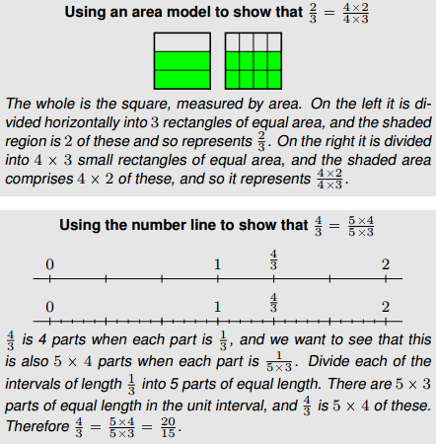
Grade 4 Standard: Extend understanding of fraction equivalence and ordering.

Slide 9
Grade 4 Standard
Apply and extend previous understandings of multiplication to multiply a fraction by a whole number.
Understand a fraction a/b as a multiple of 1/b. For example, use a visual fraction model to represent 5/4 as the product 5 × (1/4), recording the conclusion by the equation 5/4 = 5 × (1/4).

Slide 10
Grade 5 Standards
Apply and extend previous understandings of multiplication to multiply a fraction or whole number by a fraction.
Solve real-world problems involving multiplication of fractions and mixed numbers, e.g., by using visual fraction models or equations to represent the problem.

Slide 11
The Importance of Context
Builds meaning for operations
Develops understanding of and helps illustrate the relationships among operations
Allows for a variety of approaches to solving a problem

Slide 12
Contexts for Modeling Multiplication of Fractions
The Andersons had pizza for dinner, and there was one-half of a pizza left over. Their three boys each ate one-third of the leftovers for a late night snack.
How much of the original pizza did each boy get for snack?

Slide 13
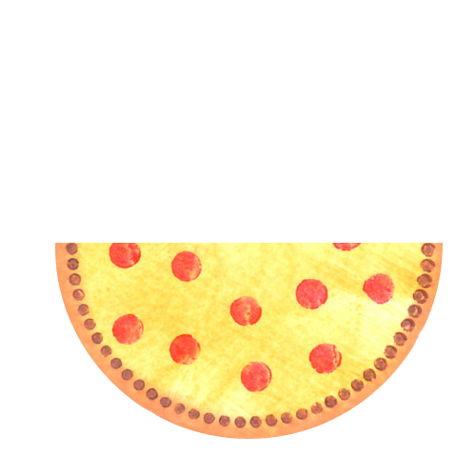

One-third of one-half of a pizza is equal to one-sixth of a pizza.

Slide 14
Another Context for
Multiplication of Fractions
Mrs. Jones has 24 gold stickers that she bought to put on perfect test papers. She took of the stickers out of the package, and then she used of that half on the papers.
What fraction of the 24 stickers did she use on the perfect test papers?

Slide 15
One-third of one-half of the 24 stickers is of the 24 stickers.
Problems involving discrete items
may be represented with set models.

Slide 16
Solve each problem using pictures and/or manipulatives.
1. Your family has just bought 12 doughnuts. Since there are 4 people in your family, your parents tell you that you may have 1/4 of the 12 doughnuts. How many doughnuts do you get to eat?
2. Your dad comes in for his share of the doughnuts and finds that 3/4 of them have already been eaten. How many of the 12 doughnuts have already been eaten?
3. You have ¾ of a pizza left. If you give 1/3 of the leftover pizza to your brother, how much of a whole pizza will your brother get?
4. Wayne filled 5 glasses with 2/3 liter of soda in each glass. How much soda did Wayne use?
5. Aryanna had 2/3 of the lawn left to cut. After lunch, she cut ¾ of the grass she had left. How much of the whole lawn did Aryanna cut after lunch?

Slide 17
SBAC Problems
Solve each of the following problems.
What does a student need to understand to be successful on each of these tasks?
Choose one of the problems and increase the DOK level. Generate some posing and probing moves to help students be successful on your task.
Choose one of the problems and decrease the DOK level. Generate some posing and probing moves to help students be successful on your task.
Notes:
How do diagrams help reveal the type of problem?
How do diagrams help reveal the type of problem?

Slide 18
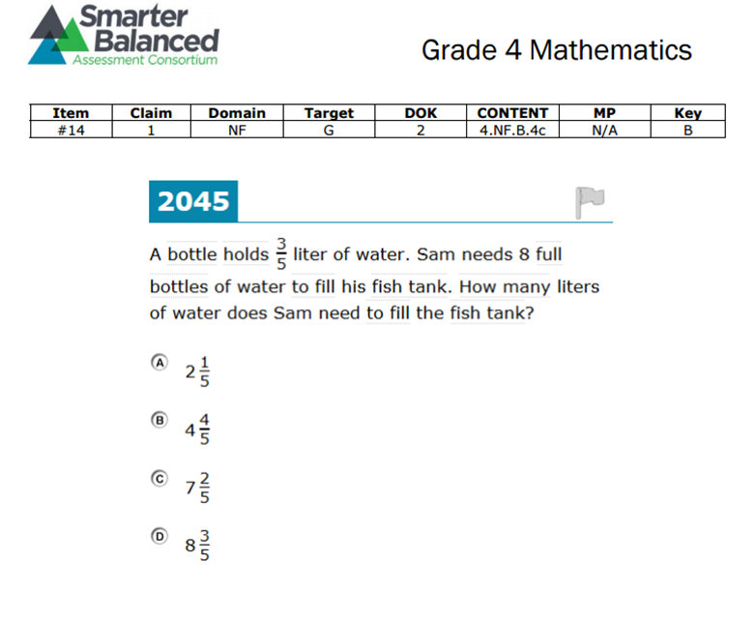

Slide 19
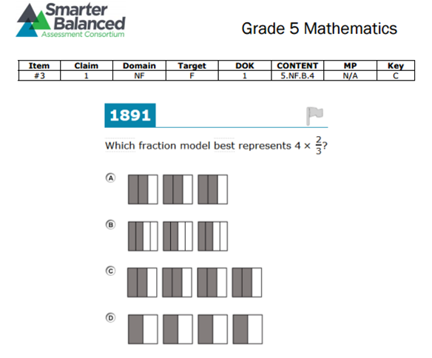

Slide 20
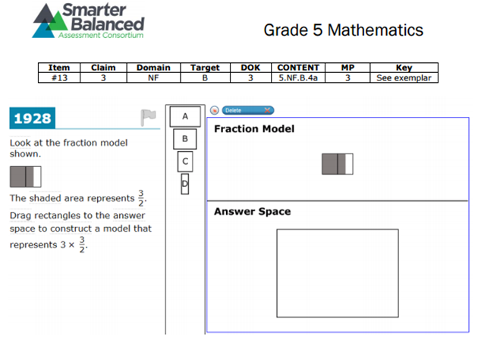

Slide 22
Joakim is icing 30 cupcakes. He spreads mint icing on 1/ 5 of the cupcakes and chocolate on 1/ 2 of the remaining cupcakes. The rest will get vanilla frosting. How many cupcakes have vanilla frosting?
Use a tape diagram to model this problem.
Engage NY Grade 5 Lesson 16 (p. 244)
Notes:
Investigate other bar model problems in Grade 5 if time.

Slide 23
Adapting the problem.
Joakim is icing a cake. He spreads vanilla frosting on 2/3 of the cake and then eats ¼ of the cake with vanilla icing. How much of the cake will have vanilla frosting?
What diagram can you use to model this problem?
Notes:
Investigate other bar model problems in Grade 5 if time.

Slide 24
Planning and Application
Find where your text begins to address fractions.
How could you use some of the fraction activities you experienced today to enhance the text and build conceptual understanding?
Outline a unit specifying where these activities could be used productively.

Slide 25
Survey

