Slide 1
Franklin-McKinley Math Institute
June 19, 2017

Slide 2
Why Use Math Games
Games create a context for developing mathematical reasoning and understanding. They:
  Develop problem solving skills
  Develop number sense
  Encourage strategic thinking
  Encourage discussion
  Help develop computational fluency
  Are motivating for children
  Are fun
  Encourage parent participation
  Promote confidence and positive attitudes toward math
  Meet the needs of diverse learners

Slide 3
Kenkenpuzzle.com

Slide 4
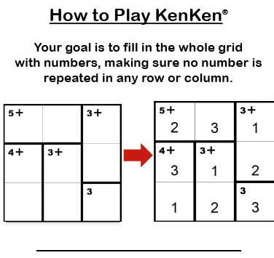

Slide 5
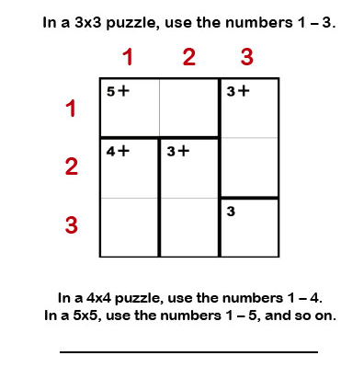

Slide 6
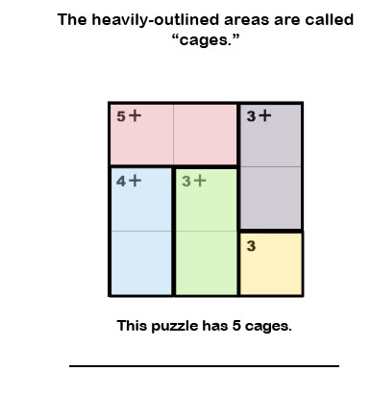

Slide 7
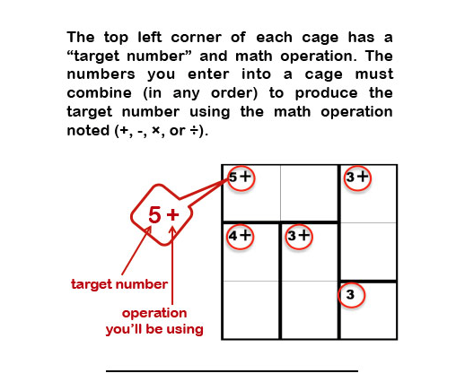

Slide 8
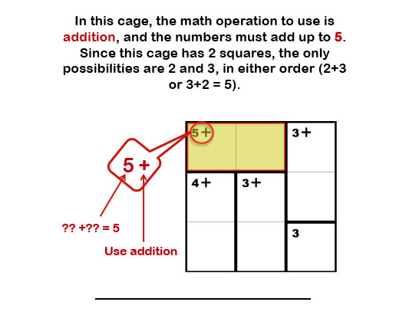

Slide 9
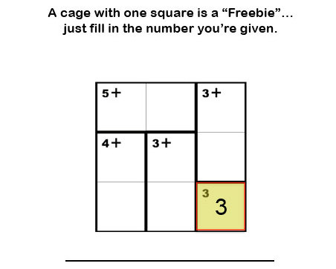

Slide 10
Play!
Try to develop some strategies

