Slide 1
Mapping Curriculum Units and Assessment Tasks with the Clusters
Ferdie Rivera
SJSU
June 2016

Slide 2
FMMI Project Website
We have a project website!!!
http://rfdr266.wix.com/fmmi

Slide 3
Mapping Curriculum Units with the Clusters
Work within grade level groups.
Read the major, supporting, and additional clusters for your grade level.
Focus on the major standards first.
  Grades 3-5: Map units from EngageNY that address the major standards.
  Grade 6: Map units from CPM that address the major standards.
Then map curriculum units to supporting and additional standards.

Slide 4
Mapping Appropriate Assessment Tasks with Each Cluster
Identify tasks that can be used with each cluster.
  CAASPP –
    http://www.caaspp.org/ta-resources/practice-training.html
  Illustrative Math Project –
    https://www.illustrativemathematics.org/
  Achieve the Core –
    http://achievethecore.org/

Slide 5
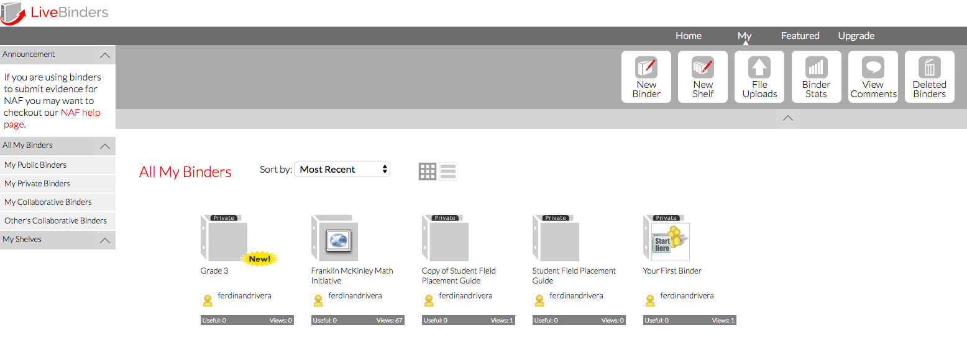
Livebinder Digital Resource
http://www.livebinders.com/welcome/home
You will need to sign up.
Once you have an account, go for it!
  Create a new Binder with label “Grade X.”

Slide 6
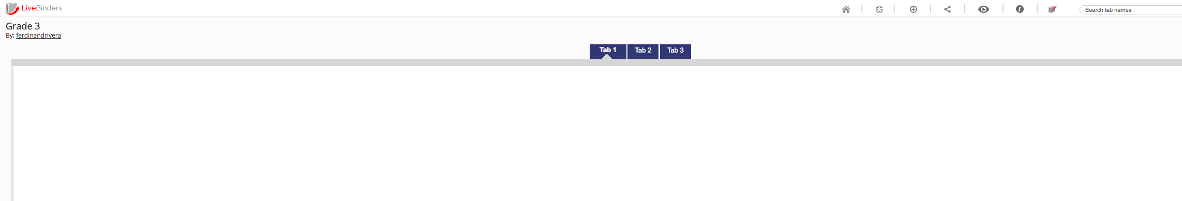
Livebinder Structure
Open Grade X binder.

Slide 7
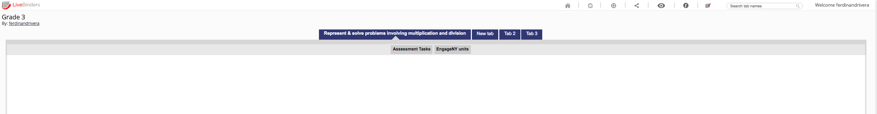
Livebinder Structure
Develop a structure for your binder.

